Slide 1
Efficient forecasting and uncertainty quantification for large scale account level Monte Carlo models of debt recovery
Abhishek Thomas

Slide 2
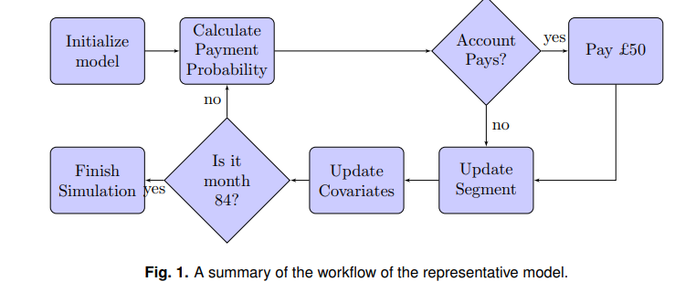
1st section
-Forecasting round-
estimate no debt recovery of NPL
All account, multiple realization from individual account (logistic regression outcome ) aggregated to find population estimate
Update it
Input
-payment behaviour upto 7 years of each account
output
total monthly amount calculated for the next 7 years – 84 points
Probability of that payment

Slide 3
Challenges faced
Comutation complexity
Soln- optimal allocation of realizations
Parallel to multilevel monte carlo & Bayesian design experiment
2- Uncertaininity probability
Soln- make prediction intervals
Sample variance reduction technique
3- efficient use of computation resource
Soln- Gaussian process emulator
Aspect | Paper's Model | Arrow's Commercial Model
Model Complexity | Simplified for clarity and explanation | More complex and tailored to real-world needs
Data Inputs | Basic data like credit score, payment history, balance | Detailed data, including demographics and external credit reports
Segments and Transitions | Simple segment rules with predefined probabilities | Sophisticated segments and dynamic rules
Payment Probability | Logistic regression | Advanced machine learning techniques
Payment Amount | Assumes fixed or simple proportional payments | Detailed rules for determining payment amounts
Simulation Efficiency | Focuses on improving computational efficiency | Efficient but uses proprietary methods
Uncertainty Quantification | Develops prediction intervals to measure uncertainty | Uses additional methods like scenario analysis
Integration with Operations | Demonstrates theoretical concepts | Fully integrated into day-to-day operations
Data Granularity | Uses monthly data and biannual updates | More frequent updates (e.g., weekly or daily)

Slide 4
Aim
To create
Variance reduction technique
Uncertaininity quantification technique( by agg individual level forecast to generate population level forecast)
Section 2- Current model
Section 3- variance reduction technique
Section 4- prediction interval
Section 5- Quality of protection of population
Section 6- Gaussian emulator

Slide 5
Section 2 - Current model
-

